Slide 1

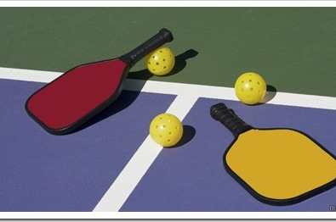
Take your Fun to the Next Level!
Customised for
XYZ
This Photo by Unknown Author is licensed under CC BY-SA-NC

Slide 2
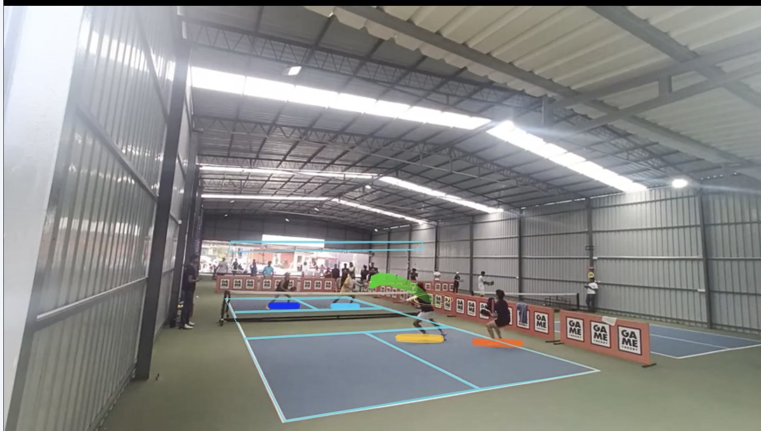
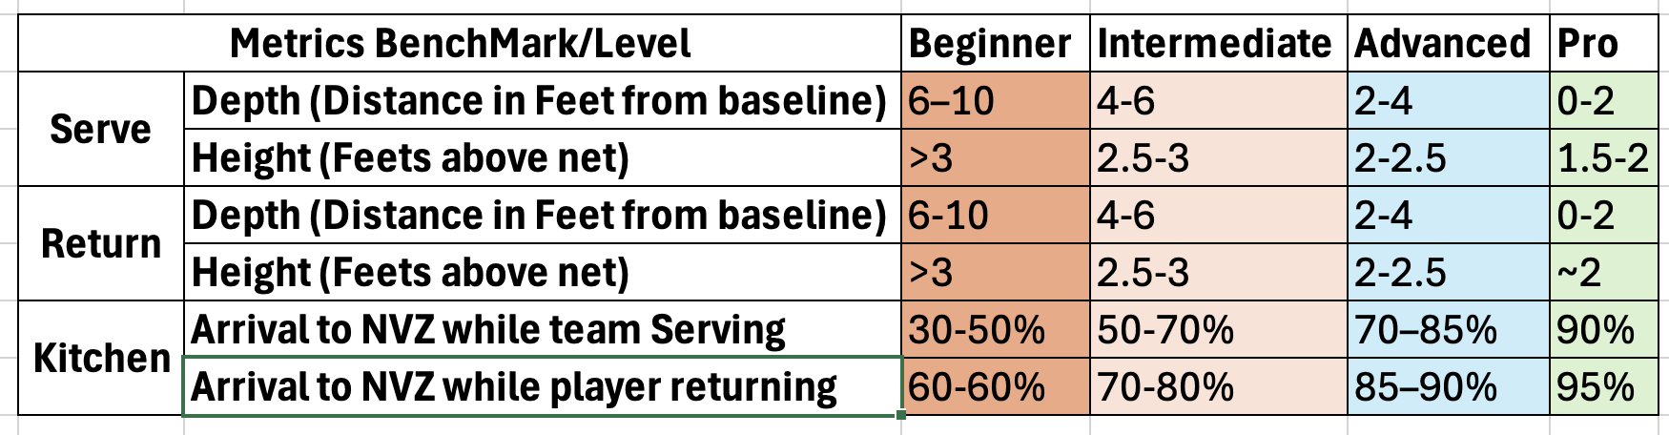
NethriQ Benchmarks

Slide 3
NethriQ Insight 1 – How effective is Player's serve?
Serve Depth Drill
NethriQ customized serve analysis and insights
Your Serve Depth is 3.80
Your Serve Height is 3.27
Here is a link to the video that summarizes all your serves
Here is a recommended drill for you to practice to help you come on your journey towards the benchmarks aimed to gradually improve this aspect towards your immediate next goal
Serve Depth Drill
Advanced level
Beginner level
Serves in Game

Slide 4
NethriQ Insight 2 – How Effective is Player’s Return
NethriQ customized Return analysis and insights
Your Return Depth is 7.65 Ft
Your Return Height is 5.34 ft
Here is a link to the video that summarizes all your Returns
Here is a recommended drill for you to practice to help you come on your journey towards the benchmarks aimed to gradually improve this aspect towards your immediate next goal
Return Depth Drill
Beginner Level
Beginner Level
Returns in Game

Slide 5
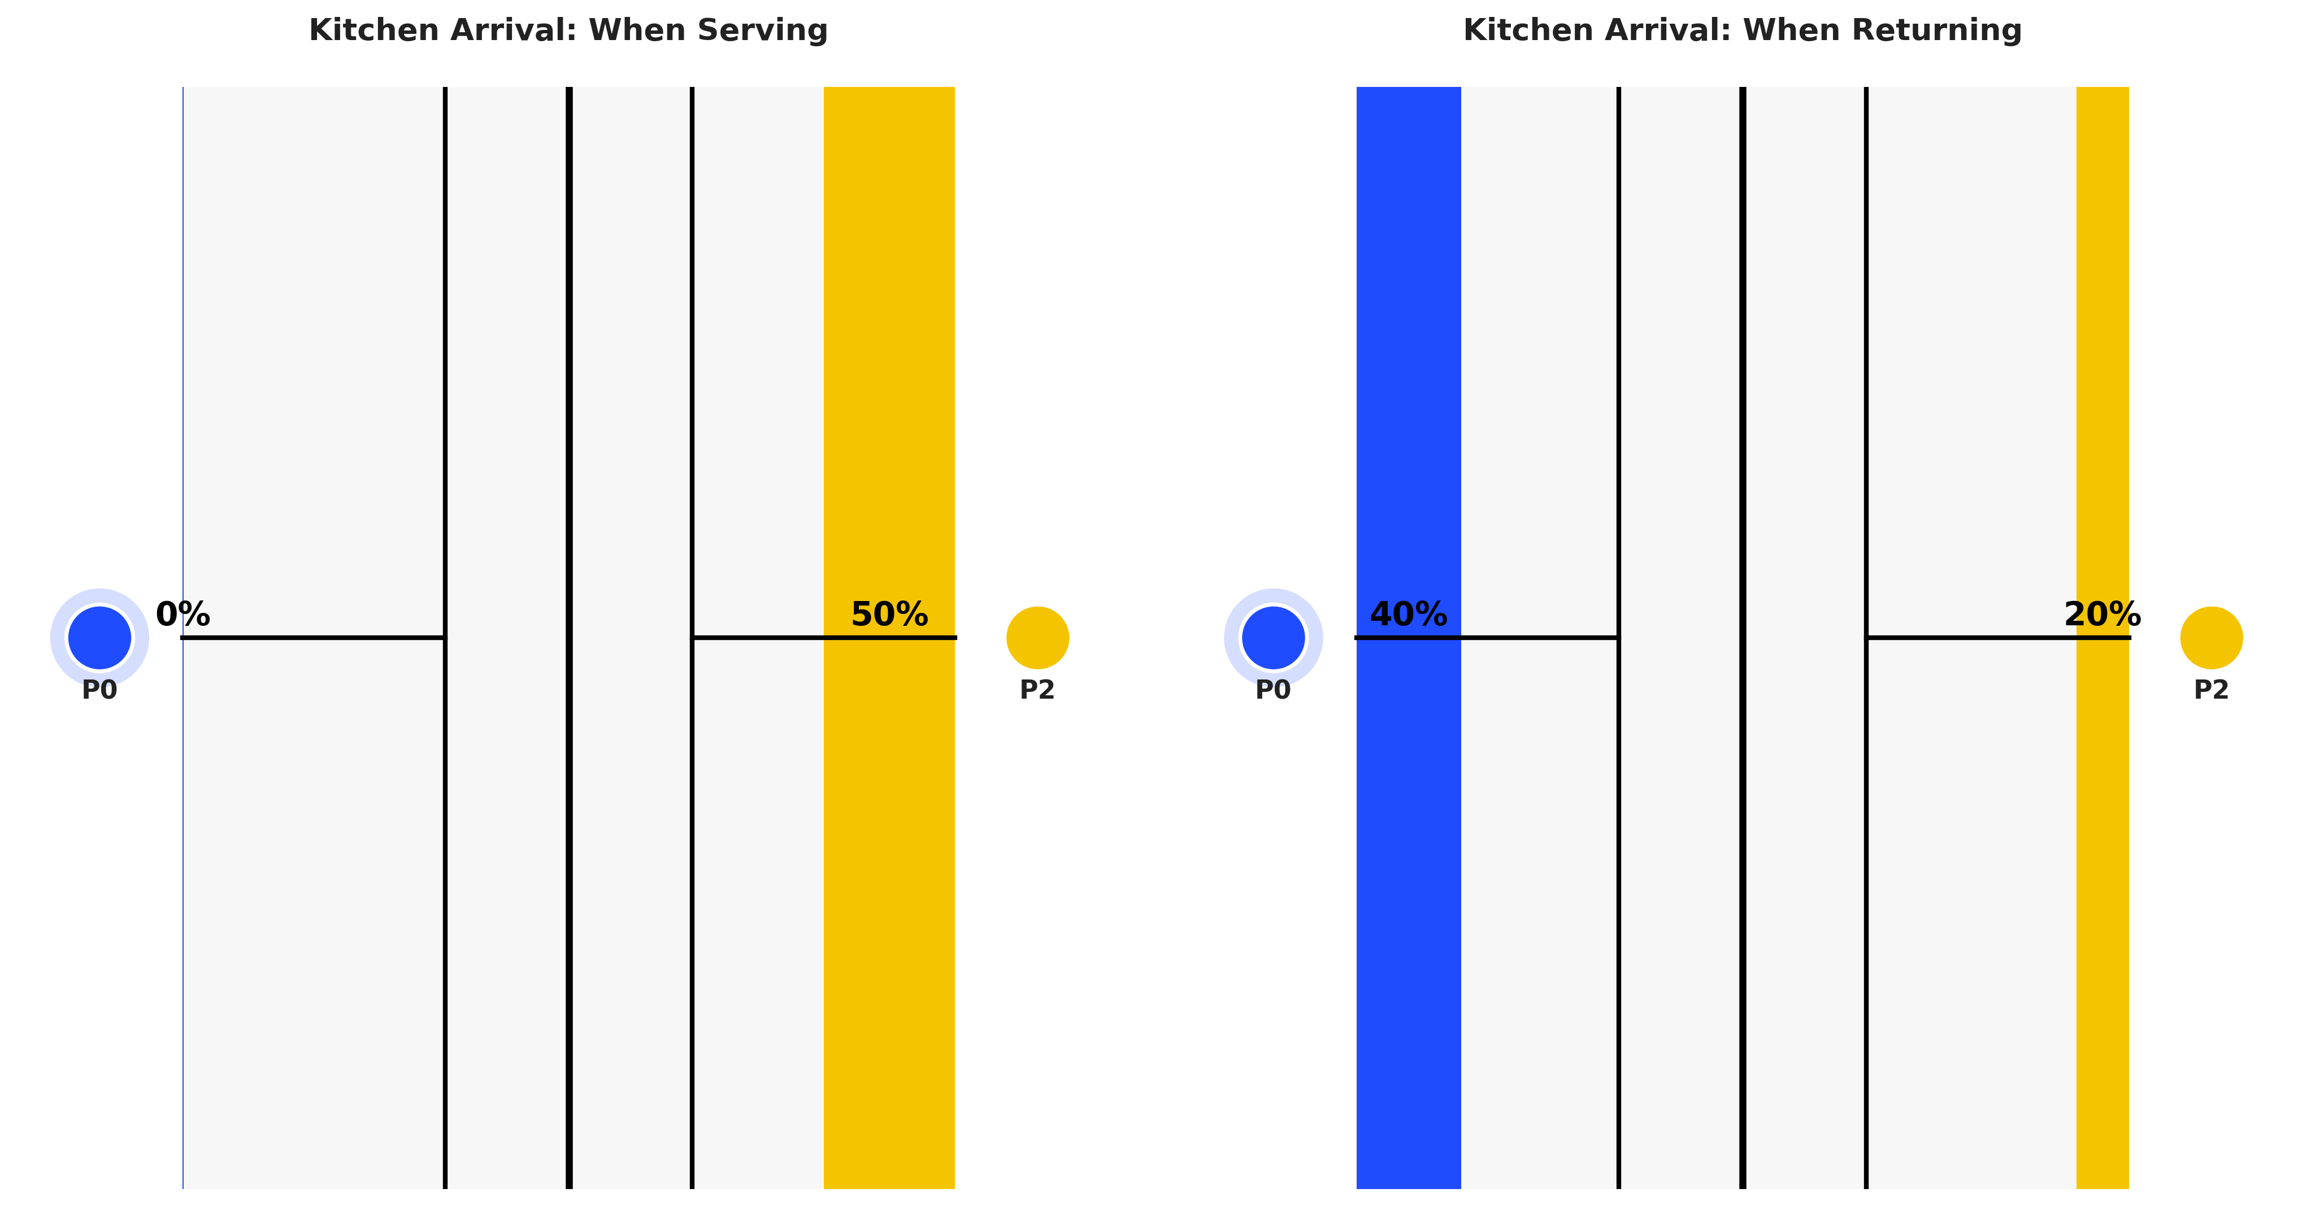
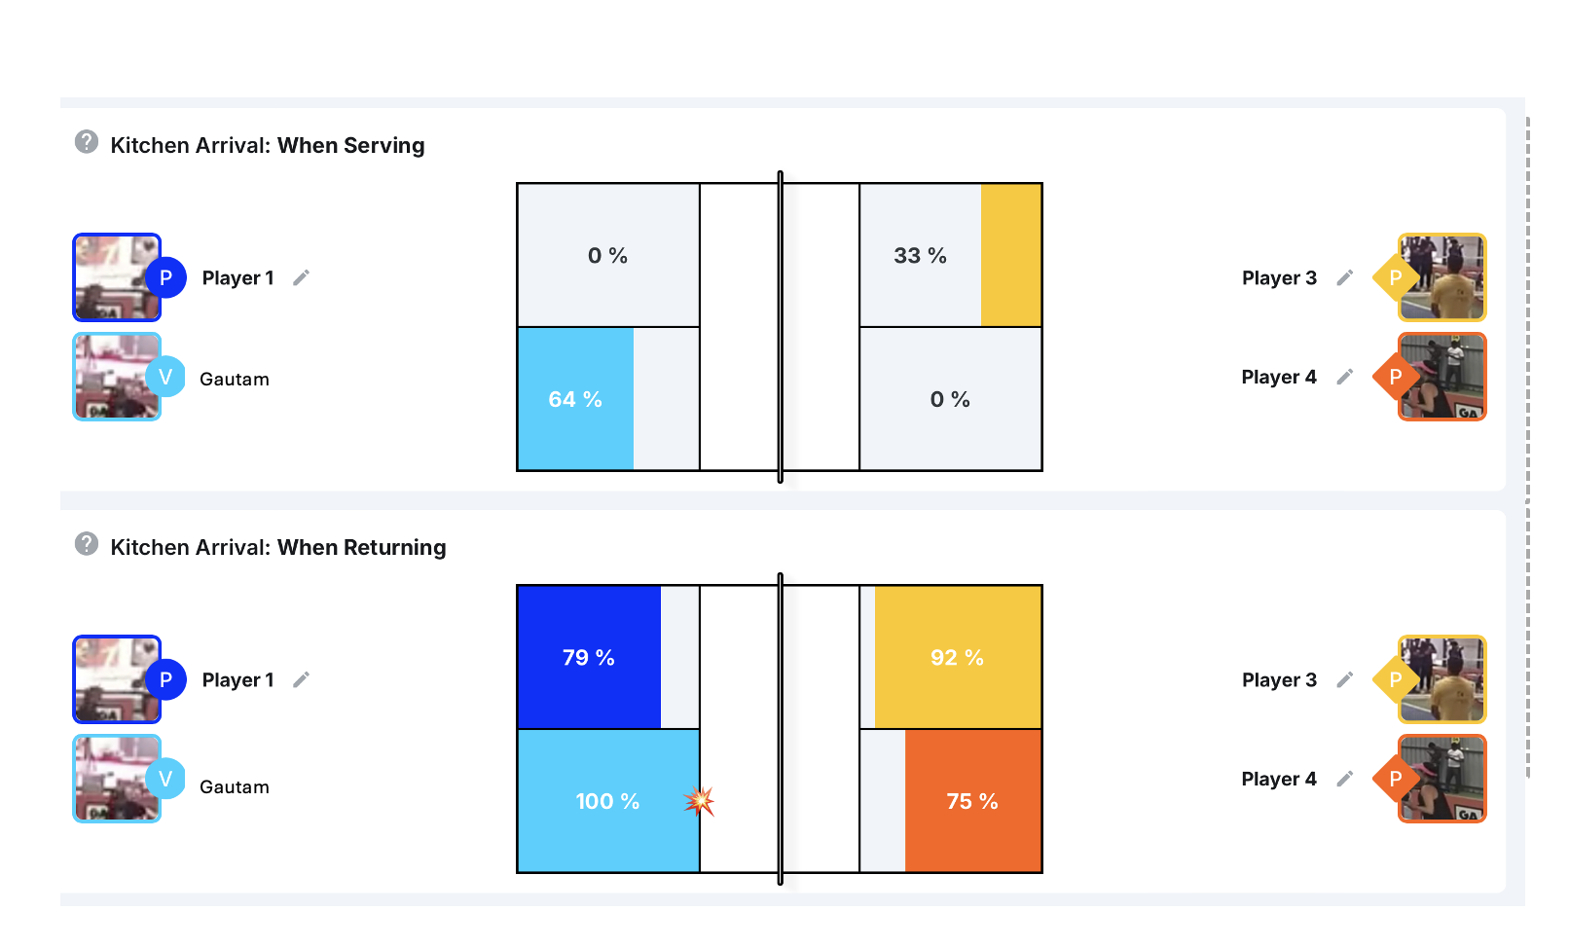
NethriQ Insight 3 – Kitchen Control
NethriQ Personalised Insight on kitchen control
Kitchen Arrival After Serve- 0%
Kitchen Arrival when Returning – 40%
Here is a link to the video that summarizes all your Kitchen Arrival
Kitchen Arrival in Game
Here is a recommended drill for you for Kitchen.
Kitchen Arrival Drill
Beginner level
Beginner level

Slide 6
NethriQ Personalised Insights Summary
Advanced Level
Serve Depth –
Serve Height –
Return Depth-
Return Height –
Kitchen Arrival on Serve-
Kitchen Arrival on Return –
Overall Game Level-
Bonus- Highlight Reel link from the Game –
Beginner Level
Beginner Level
Beginner Level
Beginner Level
Beginner Level
Beginner Level
Best Shots

Slide 7
NethriQ – Take your Fun to the Next Level
Sign up to the monthly subscription and Take Your Fun to the Next Level
Share your progress with your friends with customized reels capturing your adrenalin filled action
Improve your game and take your fun to the next level by receiving customized tips linked to your progress

